Slide 1
Probability & Statistics Fundamentals

Slide 2


Machine Learning
Linear Algebra
Probability/Statistics
Signal Processing
Algorithms and Data Structures
This lecture’s content applies to everyday life as well!!!

Slide 3
Outline
Probability theory
Descriptive Statistics & Graphical Presentation of Data
Correlation vs Causation

Slide 4
Probability

Slide 5
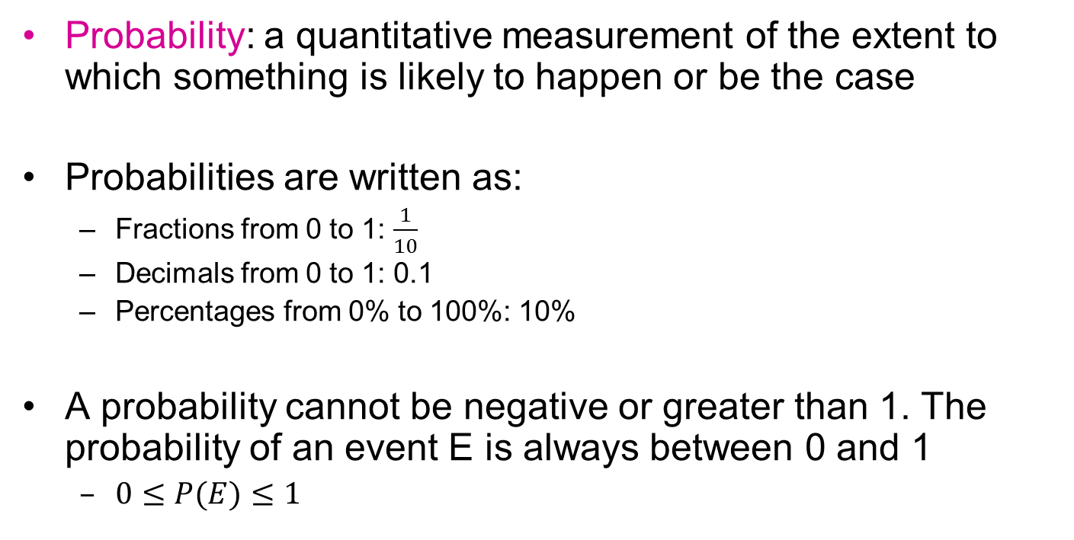
Probability
Probability: a quantitative measurement of the extent to which something is likely to happen or be the case
Probabilities are written as:
Fractions from 0 to 1: $\frac{1}{10}$
Decimals from 0 to 1: 0.1
Percentages from 0% to 100%: 10%
A probability cannot be negative or greater than 1. The probability of an event E is always between 0 and 1
$0≤P(E)≤1$
Impossible Unlikely Equal Chances Likely Certain
0 0.5 1

Slide 6
Types of probability
Classical or theoretical probability
Uses a theoretical (ideal) description of the phenomena
Empirical probability
Uses empirical evidence (samples) to derive a quantification of the phenomena

Slide 7
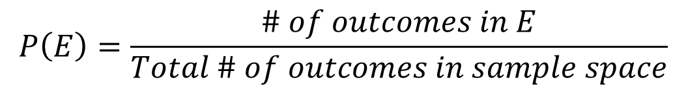
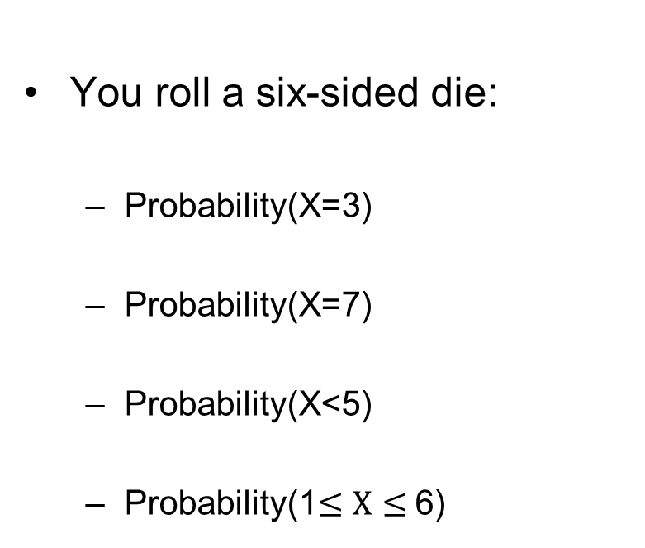
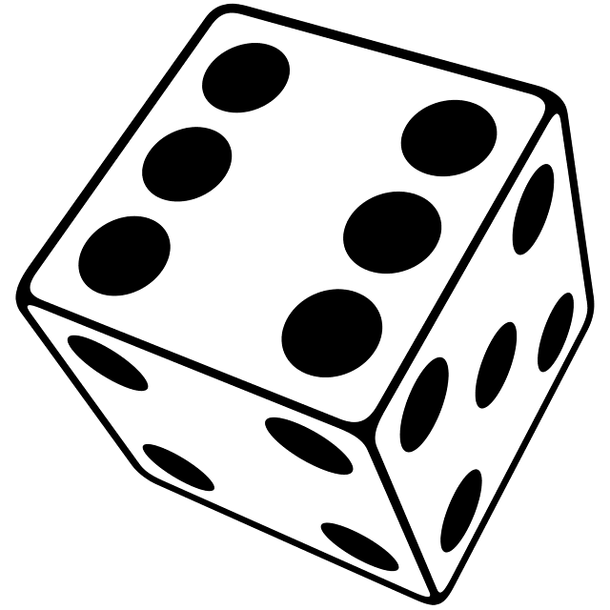
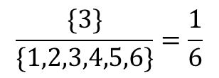
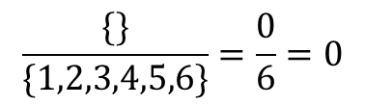
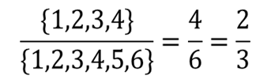
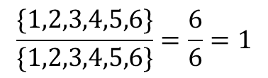
1. Classical probability

Slide 8
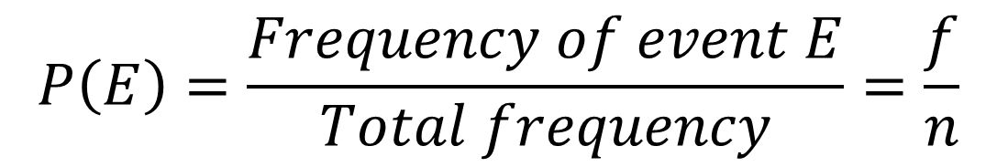
2. Empirical Probability
Based on observations obtained from probability experiments
The empirical probability of an event E is the relative frequency of observed event E (hence, the usage of the term empirical)

Slide 9
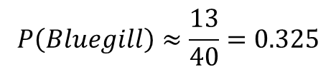
2. Empirical Probability: Example
A pond contains 3 types of fish: bluegills, redgills, and crappies. Assume each fish in the pond is equally likely to be caught (big assumption!). You catch 40 fish and record the type. Each time, you release the fish back in to the pond. The following frequency distribution shows your results.
Fish Type | # of Times Caught, (f)
Bluegill | 13
Redgill | 17
Crappy | 10
 | ∑f = 40
If you catch another fish, what is the empirical probability that it is a bluegill?
$$P\left(Bluegill\right)≈\frac{13}{40}=0.325$$

Slide 10
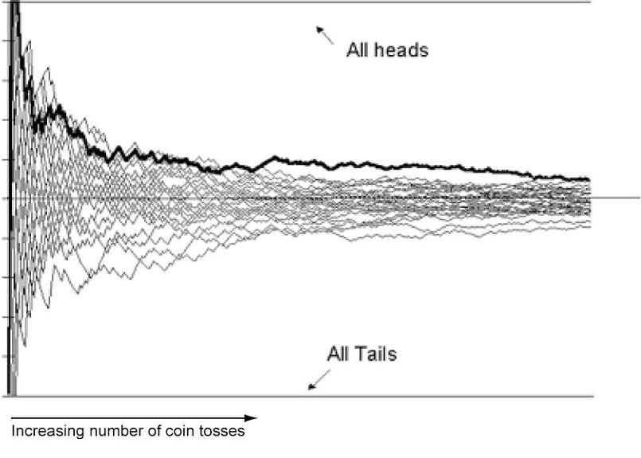
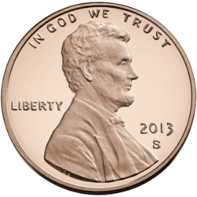
Law of large numbers
As you increase the number of times a probability experiment is repeated, the empirical probability (relative frequency) of an event approaches the theoretical probability of the event (expected value). This phenomena is known as the law of large numbers
1
Expected value
This law suggest that, at least from a mathematical standpoint, it doesn’t make sense for you to play lottery or go to the casino
0
If you maintain a running average of many coin tosses (by assigning a 1 for heads and a 0 for tails) in the long-run, the experiment will converge around an average of 0.5)

Slide 11
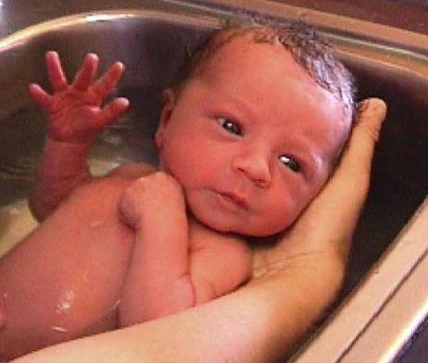
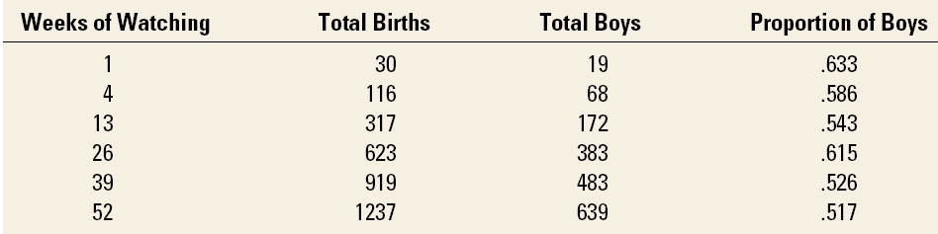
The law of large numbers: Probability of Male vs Female Births
Long-run relative frequency of males born in Christchurch is about 0.512 (512 boys born per 1000 births)
Table provides results of experiment: the proportion is far from .512 over the first few weeks but in the long run converges towards .512.

Slide 12
Complement of an event
Sometimes, we want to know the probability that an event will not happen; an event opposite to the event of interest is called a complementary event
If A is an event, its complement is A^{C} or ‾A
Example: The complement of the male event is the female event
P(A) + P(A^{C}) = 1
P(A^{C}) = 1- P(A)

Slide 13
Example
For instance, you roll a dice and let E be the event “the number is at least 5,” then the complement of E is the event “the number is less than 5.” In other words, E = {5, 6} and E^{c} = {1, 2, 3, 4}
Using the definition of the complement of an event and the fact that the sum of the probabilities of all outcomes is 1, you can determine the following formulas:
P(E) + P(E^{c}) = 1
P(E) = 1 – P(E^{c})
P(E^{c}) = 1 – P(E)
In the example of babies born in Christchurch, the probability of a female being born is 1-probability of a male being born.
P_{female}=1-P_{male}=1-0.512=0.488

Slide 14
Conditional probability
Probability of an event given that certain criteria is satisfied:
Probability of Blood Group A: P(A) = 35/100 = 0.35
Probability of Blood Group A given F: P(A|F) = 25/50 = 0.5
Probability of Male given Blood Group O : P(M|O) = 22/40 = 0.55
Blood Group | Males | Females | Total
O A B AB | 22 10 10 8 | 18 25 3 4 | 40 35 13 12
Total | 50 | 50 | 100

Slide 15
Joint probabilities
Probability of occurrence of two or more events together:
Probability of Blood Group A AND being male:
P(A ∩ Male) = 10/100 = 0.1
Don’t confuse with the conditional Probability of A given Male:
P(A|Male) = 10/50 = 0.2
Blood Group | Males | Females | Total
O A B AB | 22 10 10 8 | 18 25 3 4 | 40 35 13 12
Total | 50 | 50 | 100

Slide 16
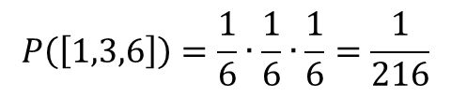

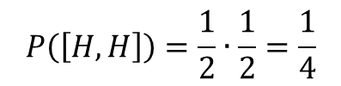
Independent Events: the occurrence of one event does not affect the probability of occurrence of the other
Probability experiment: Roll a six-sided die 3 times.
Probability experiment: Toss a coin twice

Slide 17

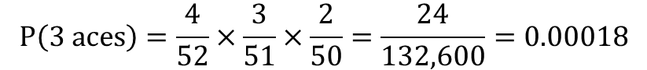
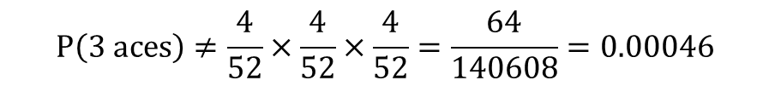
Dependent Events: the occurrence of one event does affect the probability of occurrence of the other
Three cards are chosen at random from a deck of 52 cards without replacement. What is the probability of choosing 3 aces?
$$P\left(3 aces\right)=\frac{4}{52}×\frac{3}{51}×\frac{2}{50}=\frac{24}{132,600}=0.00018$$
$$P\left(3 aces\right)≠\frac{4}{52}×\frac{4}{52}×\frac{4}{52}=\frac{64}{140608}=0.00046$$

Slide 18
Addition rule with mutually exclusive events
A and B are mutually exclusive: The occurrence of one event precludes the occurrence of the other
P(A)
P(B)
P(A OR B) = P(A U B) = P(A) + P(B)
The probability of being either blood type O or blood type A:
P(O U A) = P(O) + P(A) = (40/100)+(35/100) = 0.75
Blood Group | Males | Females | Total
O A B AB | 22 10 10 8 | 18 25 3 4 | 40 35 13 12
Total | 50 | 50 | 100

Slide 19
Addition rule with not mutually exclusive events
A and B are not mutually exclusive: Can occur together i.e. Male and smoker
P(A)
P(B)
P(A OR B) = P(A U B) = P(A) + P(B) - P(A ∩ B)
Two events are not mutually exclusive (male gender and blood type O).
P(M OR O) = P(M)+P(O) – P(M∩O) = 0.50 + 0.40 – .22= 0.68
Blood Group | Males | Females | Total
O A B AB | 22 10 10 8 | 18 25 3 4 | 40 35 13 12
Total | 50 | 50 | 100

Slide 20
Statistics

Slide 21
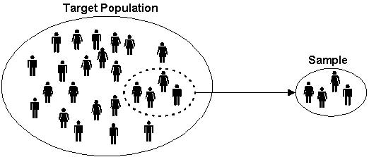
Terminology: Populations & Samples
Population: the complete set of individuals, objects or scores of interest
Often too large to sample in its entirety
It may be real or hypothetical (e.g. the results from an experiment repeated ad infinitum)
Sample: A subset of the population.
Random selection attempts to ensure the sample is representative of the population.
Imagine you want to study the average height of people in New Zealand.
The population would be every person in New Zealand
A sample would be a group of people ( 100, 1000, etc.) in New Zealand

Slide 22
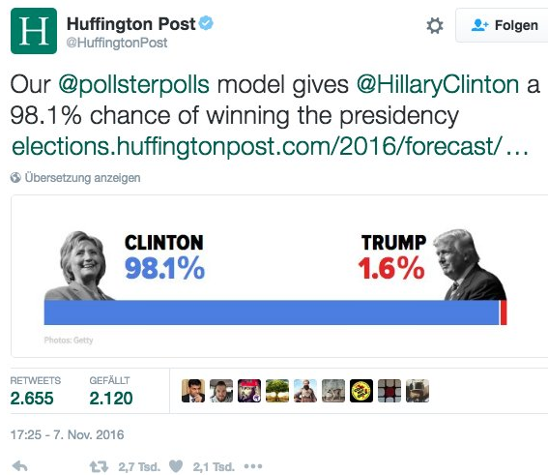
The importance of using a sample which is representative of the population

Slide 23
Variables
Variables are the quantities measured in a sample. They may be classified as:
Quantitative i.e. numerical
Continuous (e.g. Height, Income, cholesterol levels…)
Discrete (e.g. number of persons in a classroom)
Categorical
Nominal (e.g. gender, blood group, car color)
Ordinal (ranked e.g. mild, moderate or severe illness)
If the value of a variable cannot be predicted in advance then the variable is referred to as a random variable

Slide 24
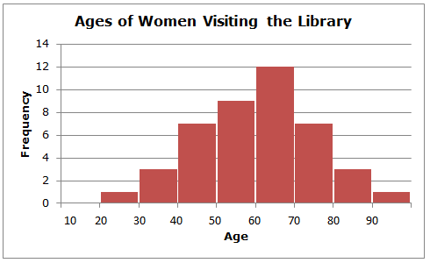
Frequency histogram
frequency table
Age range | Freq
10-20 | 0
20-30 | 1
30-40 | 3
40-50 | 7
50-60 | 9
60-70 | 12
70-80 | 7
80-90 | 3
90-100 | 1
Frequency Histogram
A bar graph that represents the frequency distribution
The horizontal scale is quantitative and measures the range of data values
The vertical scale measures the frequencies of the classes/events

Slide 25
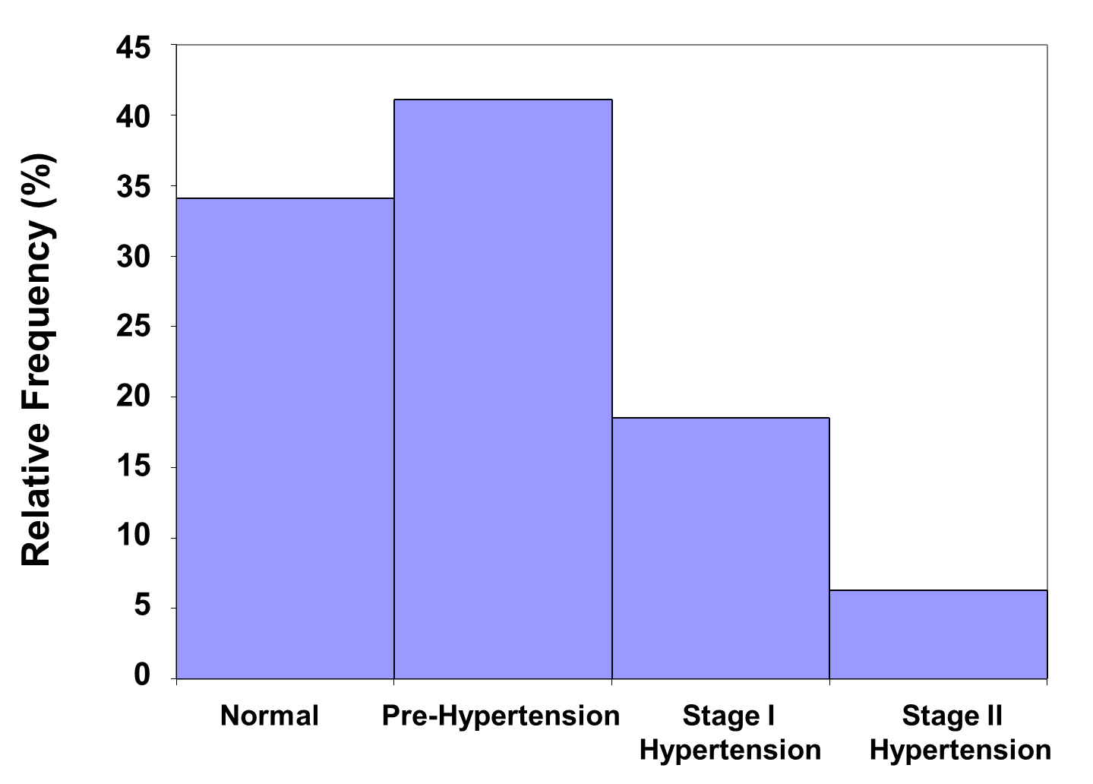
Relative Frequency Histogram
Has the same shape and horizontal scale as a histogram, but the vertical scale is marked with relative frequencies.

Slide 26
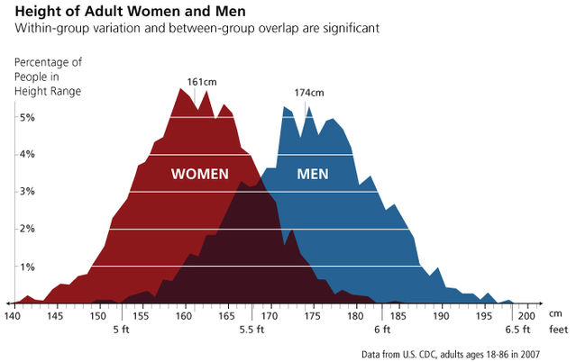
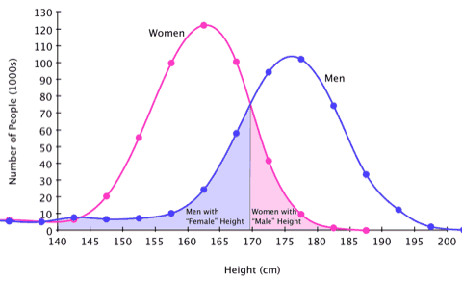
A Frequency distribution (left) will converge to a probability distribution/density curve (right) as number of samples N gets larger
Note of caution:
Trait

Slide 27

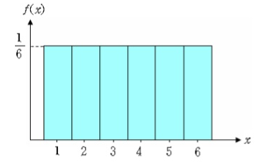
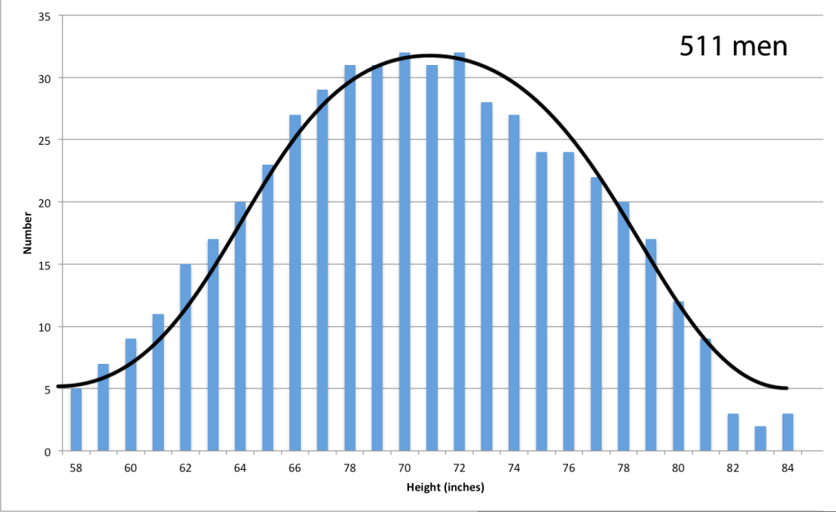
If I sample often enough from a population, I will get a frequency distribution that characterizes the population

Slide 28
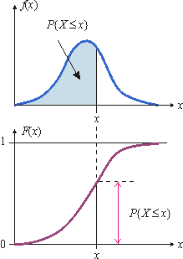
Cumulative distribution function
Probability distribution
function
The cumulative distribution function (CDF) of a real-valued random variable X, or just distribution function of X, evaluated at x, is the probability that X will take a value less than or equal to x.
Cumulative distribution function

Slide 29
Distributions: 3 useful features
We want to summarize important characteristics of the data distribution such as:
Where is middle of distribution?
How variable/wide is distribution?
What is shape of the distribution?

Slide 30
Measures of Central Tendency (Location)
Measures of location to indicate where on the number line the data are to be found. Common measures of location are:
Arithmetic Mean
Median
Mode (the most frequent value in a sample)

Slide 31
The Mean
Let x₁,x₂,x₃,…,x_{n} be the realised values of a random variable X, from a sample of size n. The sample arithmetic mean is defined as:
Example: The systolic blood pressure of 7 middle aged men were:
151, 124, 132, 170, 146, 124 and 113.

Slide 32
The Median
If the sample data are arranged in increasing order, the median is
the middle value if n is an odd number, or
midway between the two middle values if n is an even number
The reordered systolic blood pressure data seen earlier 151, 124, 132, 170, 146, 124 and 113 are:
113, 124, 124, 132, 146, 151, 170
The Median is the value in the middle of the ordered data: 132

Slide 33
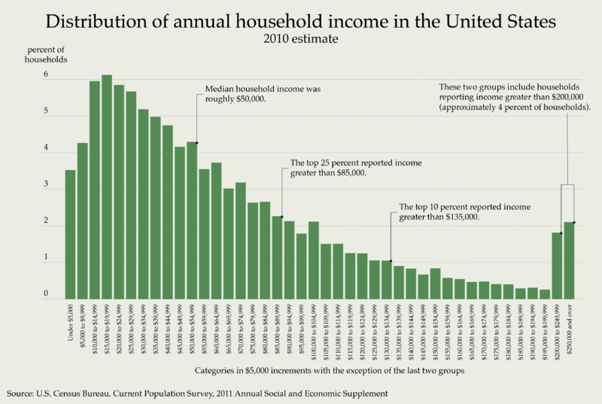
Subtle difference between the mean and the median (or how statistics are shamelessly used to manipulate people)
Mean household income was 70,000
Notes:
“income” mixes earnings with capital gains

Slide 34
Measures of Dispersion/variability
Measures of dispersion characterise how spread out the distribution is, i.e., how variable the data are
Commonly used measures of dispersion include:
Range
Variance & Standard deviation

Slide 35
Range
the sample Range is the difference between the largest and smallest observations in the sample
easy to calculate;
Blood pressure example:
113, 124, 124, 132, 146, 151, 170
min=113 and max=170, so the range is 170-113=57 mmHg
sensitive to extreme values ☹

Slide 36
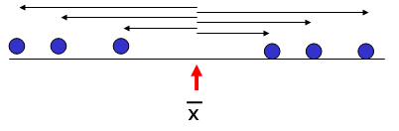
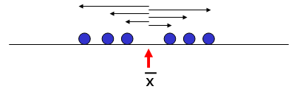
Sample Variance
The sample variance, s², is the arithmetic mean of the squared deviations from the sample mean:
>
[0,2,4,6,8,10]
[2,3,4,6,7,8]

Slide 37
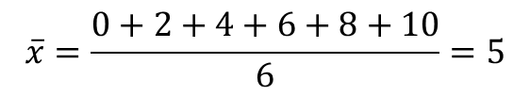
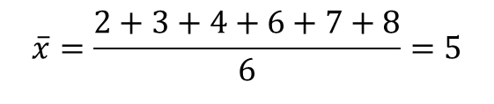
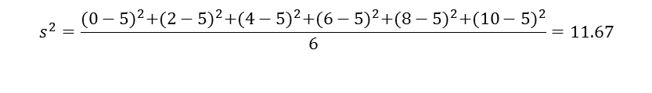
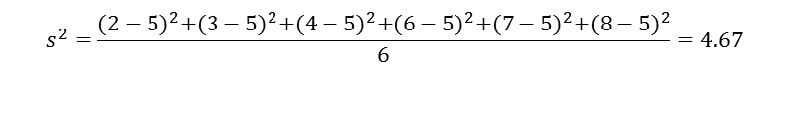
Sample Variance
>
[0,2,4,6,8,10]
[2,3,4,6,7,8]

Slide 38
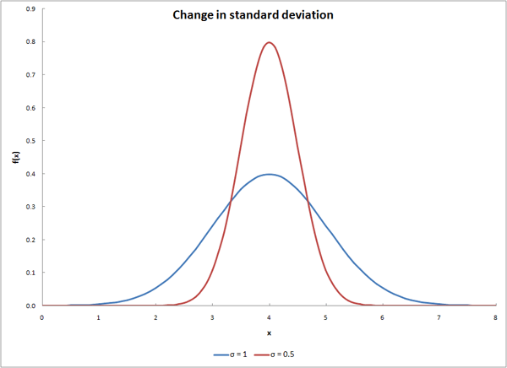
Standard Deviation
The sample standard deviation, s, is the square-root of the variance
s has the advantage of being in the same units as the original variable x
standard deviation: 0.5
standard deviation: 1

Slide 39
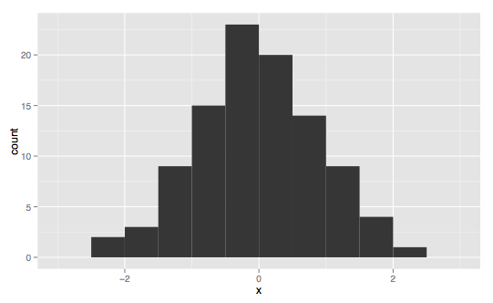
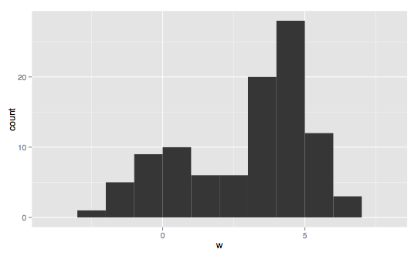
Mode of distributions
Unimodal distribution
single value is most frequent
Bimodal (or multimodal )
2 most frequently occurring values
May indicate relevant subgroups
i.e. Height of males and females in a population

Slide 40
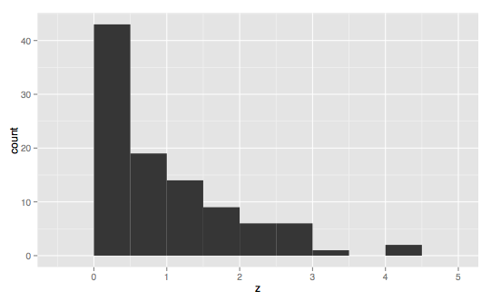
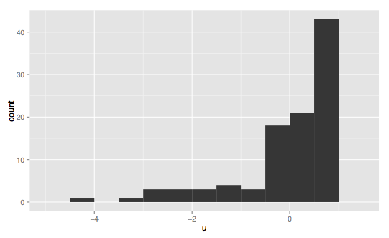
Symmetry of distributions
Symmetric: if the left half of its histogram is roughly a mirror image of its right half
Skewed – asymmetric: Data is skewed if it is not symmetric and if it extends more to one side than the other
Positively skewed: right tail longer
Negatively skewed: left tail longer

Slide 41
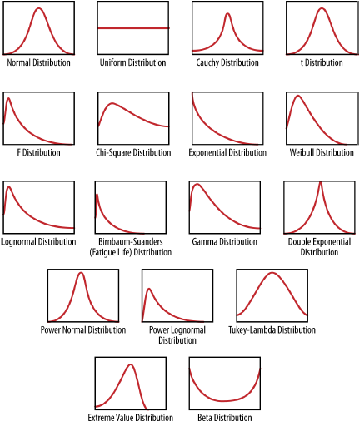
“Shape” of Distributions

Slide 42
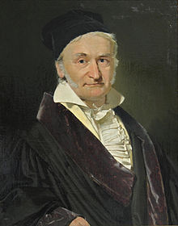
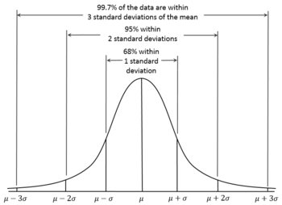
The Normal/Gaussian Distribution
The Normal distribution is considered to be the most important distribution in statistics
The Normal distribution has a symmetric bell-shaped density curve
Characterised by two parameters, i.e. the mean μ, and standard deviation σ
It emerges very often from processes consisting of a very large number of elements acting in an additive manner

Slide 43
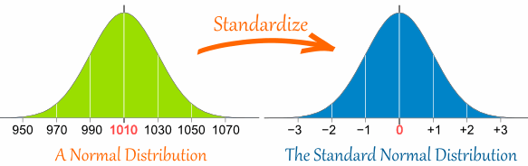
Standard Normal distribution
Standardizing a normal distribution allows us to compare distributions that use different units
If X is a Normally distributed random variable with mean = μ and standard deviation = σ, then X can be converted to a Standard Normal random variable Z using:
Z has mean = 0 and standard deviation = 1
This is a type of feature scaling often used in machine learning

Slide 44
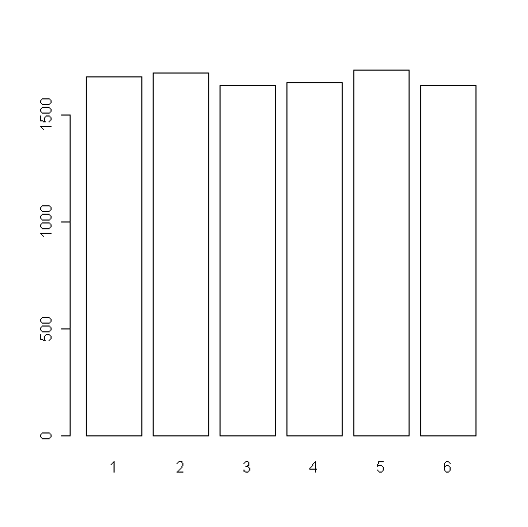
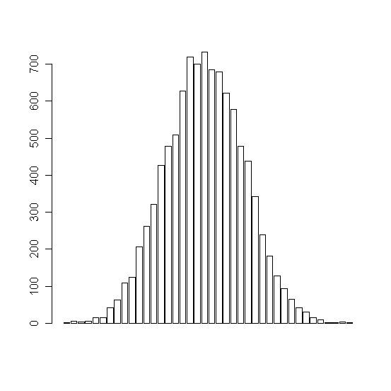
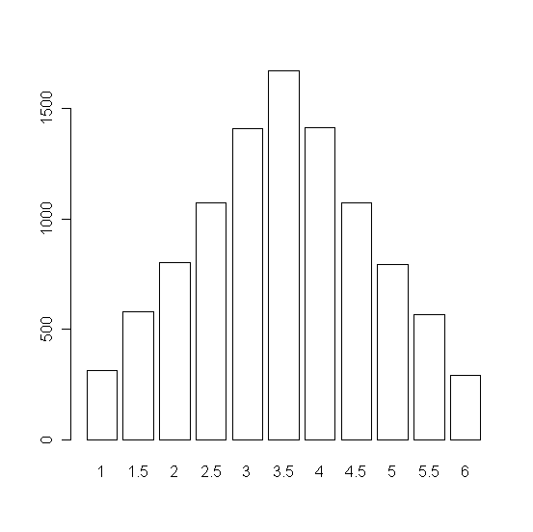
Central Limit Theorem: CLT (optional)
The CLT states that, for large sample sizes, the distribution of sample means is the Normal Distribution
Toss 1 dice
Histogram of
data
Toss 2 dice
Histogram of averages
Toss 10 dice
Histogram of averages
Distribution of data
is far from Normal
Distribution of averages approach Normal as sample size (no. of dice) increases

Slide 45
Correlation vs causation
Correlation indicates a relationship between two events.
For example, these two events tend to happen at the same time.
Causation indicates that the occurrence of one event has caused the occurrence of a second event.
These two events also happen at the same time, but there is a causal link!

Slide 46

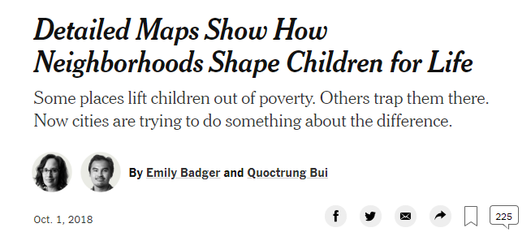
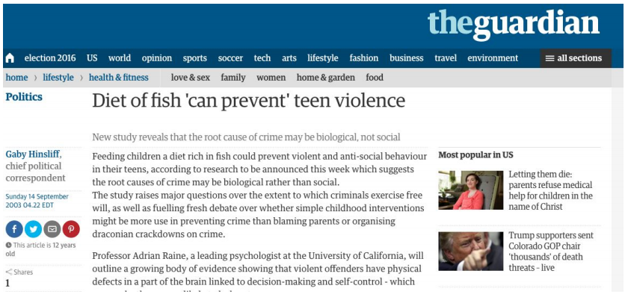
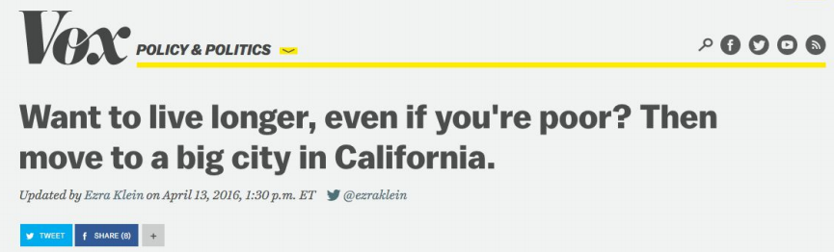
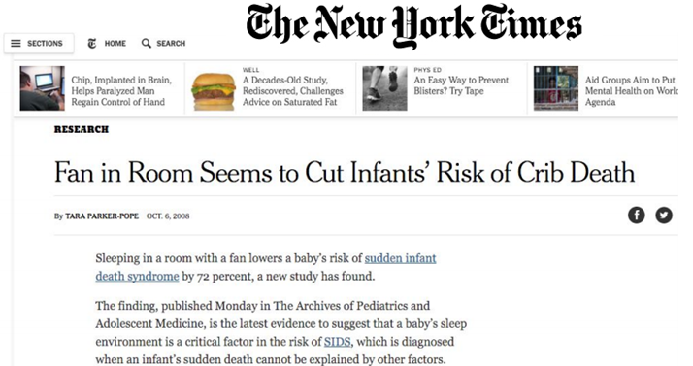

Correlation is often conflated with causation by the media and other social institutions

Slide 47


Correlation
A correlation measures the “degree of association” between two variables
Associations can be positive (an increase in one variable is associated with an increase in the other) or negative (an increase in one variable is associated with a decrease in the other)

Slide 48
Correlation does not imply causation
Causation means that whenever there is a change in an explanatory variable, it should cause in a change in the response variable.
Correlations: Correlations between two variables are extremely common and easy to find. However, saying that two variables are correlated in NO way guarantees that there is causation.
Often (very, very often!) people report “associations” (i.e. correlation) between two variables while implying causation.
Yet upon further examination, it turns out that there is not causation whatsoever!
As humans, though, upon hearing about “associations” we often jump to an assumption of causation.
Most of the time, the causation simply is NOT there
Causation is infrequent in nature
Correlations are more common

Slide 49
Ice-cream sales are strongly correlated with crime rates. Therefore, ice-cream consumption causes crime????
Pizza consumption and cancer rate: r = -. 5
Gun ownership and crime: r = .71
Number of cavities in elementary school children and their vocabulary size: r = -.6
Ice cream consumption and shark attacks in Australia: r=0.37
BMI and amount of graffiti and litter in city dwellers: r = .45
Average global temperature and number of pirates: r = -.93
IQ scores and TV time: r = -.54

Slide 50


More spurious correlations
Marriage causes drowning?
Eating a lot of cheese will make people more likely to earn a PhD in engineering?
Notes:
Basically, any 2 processes that have increased (or decreased) over time will be correlated

Slide 51
Causation Is Not Symmetric
Correlation is a necessary condition for a causal relationship, but not a sufficient one
Example: Using ashtray & suffering lung cancer
Correlation is symmetric
Parents income is correlated with school grades of children
Grades of children correlated with parents income
Causation is not symmetric
Smoking causes cancer
Suffering cancer causes smoking (???)
Incom
Grade
Smok
Canc

Slide 52

Correlation does not equate causation
In many situations, two correlated variables are not linked with a casual relationship directly. But there is a hidden variable that determines the association. This is the confounding variable
Using ashtray ⬅+correlation ➔ lung cancer
Smoking
Hidden variable
Confounding variable
Lurking variable

Slide 53


Gold standard to establish causation: Randomized study
control group
Group with characteristic A
Random assignment
experimental group
Group with characteristic B
Randomize studies can irrefutably establish causation links
Observational studies can only provide correlation

Slide 54
References
https://www.coursehero.com/file/14317301/02-math-essentials/

